Slide 1

Android Studio
#3
Android Studio
“ Navigation, but within Compose? “

Slide 2
INNEHÅLLSFÖRTECKNING
01
03
02
04
Översikt
Alternative?
Original Navigation
NEW APPROACH

Slide 3
01
Översikt

Slide 4
Navigation
(Structure)
NavController: Responsible for navigating between destinations—that is, the screens in your app.
NavGraph: Maps composable destinations to navigate to.
NavHost: Composable acting as a container for displaying the current destination of the NavGraph.
Det finns mycket…
Men vi ska titta på en enklare ‘approach’

Slide 5
02
Simple Navigation

Slide 6

The structure

Slide 7
Navigation
(Setup)
val navController = rememberNavController()
NavHost(navController = navController, startDestination = "login") {
composable("about") {
About(navController)
}
composable("login") {
Login(navController)
}
composable("signin") {
Signin(navController)
}
// Add more composable destinations as needed
}

Slide 8
Navigation
(Navigate)
@Composable
fun About(navController: NavHostController) {
Row {
Text("About Screen")
Button(onClick = {
navController.navigate("login")
}){
Text(text = "navigate")
}
}
}

Slide 9
Helheten
(Navigate)
class MainActivity : ComponentActivity() {
override fun onCreate(savedInstanceState: Bundle?) {
super.onCreate(savedInstanceState)
setContent {
Test_16Theme {
Surface(
color = MaterialTheme.colorScheme.background
) {
MyApp()
}
}
}
}
}
@Composable
@Preview
fun MyApp() {
val navController = rememberNavController()
Surface(
modifier = Modifier.fillMaxSize(),
color = MaterialTheme.colorScheme.background
) {
NavHost(navController = navController, startDestination = "login") {
composable("about") {
About(navController)
}
composable("login") {
Login(navController)
}
composable("signin") {
Signin(navController)
}
// Add more composable destinations as needed
}
}
}
@Composable
fun About(navController: NavHostController) {
Row {
Text("About Screen")
Button(onClick = {
navController.navigate("login")
}){
Text(text = "navigate")
}
}
}
@Composable
fun Login(navController: NavHostController) {
Row {
Text("Login Screen")
Button(onClick = {
navController.navigate("signin")
}) {
Text(text = "navigate")
}
}
}
@Composable
fun Signin(navController: NavHostController) {
Row {
Text("Signin Screen")
Button(
onClick = {
navController.navigate("about")
}) {
Text(text = "navigate")
}
}
}
← COPY PASTE (MAIN ACTIVITY)

Slide 10
Navigation
(Arguments)
@Composable
fun SignUpPage(navController: NavController) {
val user = User("Benny", "123")
// Sending Data to --> LoginPage
Column {
Text(text = "SignUpPage")
Button(onClick = { navController.navigate("loginPage/${user.name}/${user.password}") }) {
Text(text = "Navigate -> loginPage ")
}
}
}

Slide 11
Navigation
(Send Data)
composable(
"loginPage/{username}/{password}",
arguments = listOf(
navArgument("username") {type = NavType.StringType},
navArgument("password") {type = NavType.StringType}
)) { navBackStackEntry ->
val username = navBackStackEntry.arguments?.getString("username")
val password = navBackStackEntry.arguments?.getString("password")
LoginPage(navController = navController, username = username, password = password)
}

Slide 12
Navigation
(Show Data prop)
@Composable
fun LoginPage(navController: NavController, username: String?, password: String?) {
Column {
Text(text = "LoginPage")
Text(text = "User data: $username, $password")
Button(onClick = { navController.navigate("signInPage") }) {
}
}
}

Slide 13
03
Alternative?

Slide 14

Compose Destinations
https://github.com/raamcosta/compose-destinations

Slide 15
Dependencies

Slide 16

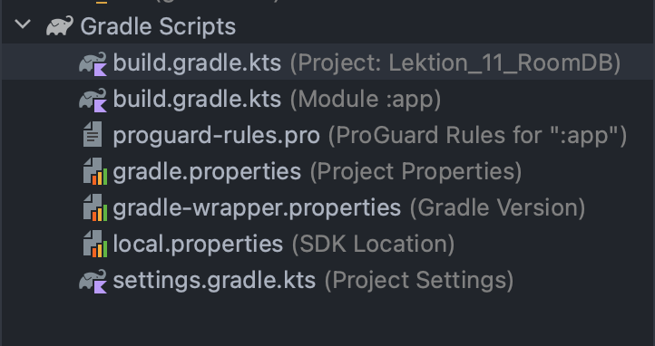
Navigate

Slide 17
First Step
// Top-level build file where you can add configuration options common to all sub-projects/modules.
plugins {
id("com.android.application") version "8.2.2" apply false
id("org.jetbrains.kotlin.android") version "1.9.23" apply false
id("com.google.devtools.ksp") version "1.9.23-1.0.19"
}

Slide 18
Navigate

Slide 19
Add Plugin
plugins {
id("com.android.application")
id("org.jetbrains.kotlin.android")
// Annotation Processor NEW
id("com.google.devtools.ksp")
}

Slide 20
Compose Options
Update Value
composeOptions {
kotlinCompilerExtensionVersion = "1.5.11"
}

Slide 21
Dependency
// https://mvnrepository.com/artifact/io.github.raamcosta.compose-destinations/core
implementation("io.github.raamcosta.compose-destinations:core:1.10.2")
ksp("io.github.raamcosta.compose-destinations:ksp:1.10.2")

Slide 22
Navigate Setup

Slide 23
onCreate()
class MainActivity : ComponentActivity() {
override fun onCreate(savedInstanceState: Bundle?) {
super.onCreate(savedInstanceState)
setContent {
Bonus_3_Compose_NavigationTheme {
// A surface container using the 'background' color from the theme
Surface(
modifier = Modifier.fillMaxSize(),
color = MaterialTheme.colorScheme.background
) {
DestinationsNavHost(navGraph = NavGraphs.root)
}
}
}
}
}
First add @Destination to your composable BEFORE doing the above! And the BUILD PROJECT

Slide 24
HomeDestination Send Data on Navigate
@RootNavGraph(start = true)
@Destination
@Composable
fun Home(navigator: DestinationsNavigator) {
Column {
Text(text = "HOME")
Button(onClick = {
navigator.navigate(
SignUpPageDestination(
username = "Benny",
password = "123"
)
)
}) {
Text(text = "Navigate")
}
}
}

Slide 25
SignUp - Props
@Destination
@Composable
fun SignUpPage(username: String, password: String) {
// Sending Data to --> LoginPage
val user = User(username, password)
Column {
Text(text = "SignUpPage")
Text(text = "$user")
Button(onClick = { }) {
Text(text = "Navigate -> loginPage ")
}
}
}

Slide 26
Animations

Slide 27
ProfileTransition
Singleton
object ProfileTransitions: DestinationStyle.Animated {
override fun AnimatedContentTransitionScope<NavBackStackEntry>.enterTransition(): EnterTransition {
return fadeIn(animationSpec = tween(500))
}
override fun AnimatedContentTransitionScope<NavBackStackEntry>.exitTransition(): ExitTransition? {
return fadeOut(animationSpec = tween(500))
}
override fun AnimatedContentTransitionScope<NavBackStackEntry>.popEnterTransition(): EnterTransition? {
return slideInHorizontally(
initialOffsetX = { -1000 }, // Start from left screen
animationSpec = tween(700)
)
}
override fun AnimatedContentTransitionScope<NavBackStackEntry>.popExitTransition(): ExitTransition? {
return slideOutHorizontally(
targetOffsetX = { 1000 },
animationSpec = tween(700)
)
}
}

Slide 28
Apply Animation
On Composable
Apply animations we’ve created
@Destination(style = ProfileTransitions::class)

Slide 29
04
NEW APPROACH

Slide 30
Dependencies

Slide 31
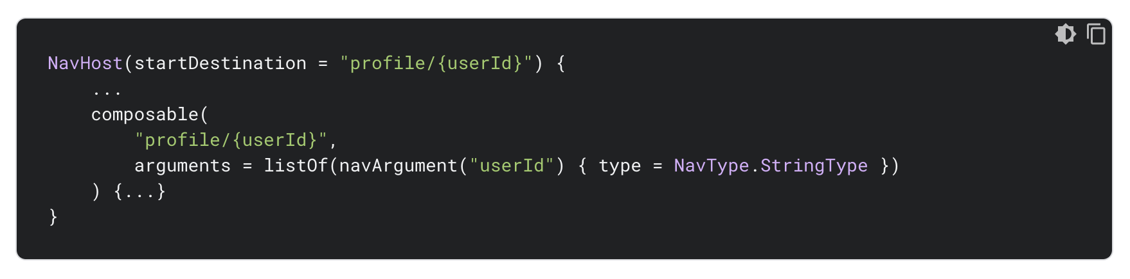
The Difference
OLD
NavHost(
navController = navController,
startDestination = Screen.Home
) {
composable<Screen.User> {
val args = it.toRoute<Screen.User>()
UserScreen(args.username, args.password, navController)
}
}
NEW

Slide 32
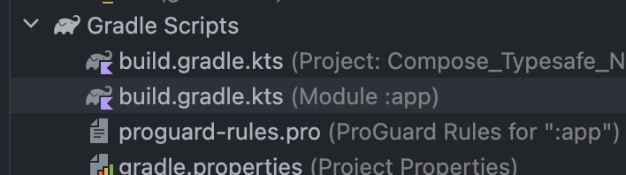
Navigate to…

Slide 33
Dependency
build.gradle
Add dependencies & plugins
plugins {
alias(libs.plugins.android.application)
alias(libs.plugins.jetbrains.kotlin.android)
alias(libs.plugins.jetbrains.kotlin.serialization)
}
dependencies {
implementation(libs.androidx.navigation.compose) // THIS
implementation(libs.kotlinx.serialization.json) // THIS
}

Slide 34
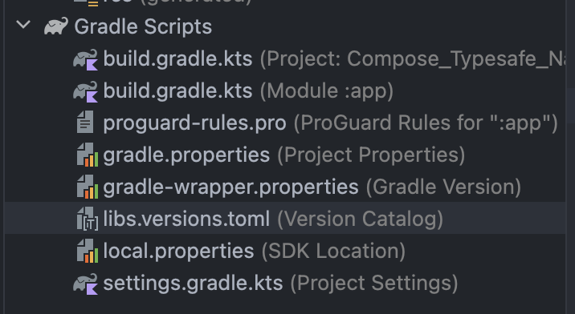
Navigate

Slide 35
Libs
Versions
COPY PASTE IF YOU ARE HAVING TROUBLES
[versions]
agp = "8.4.0"
kotlin = "1.9.23"
coreKtx = "1.13.1"
junit = "4.13.2"
junitVersion = "1.1.5"
espressoCore = "3.5.1"
lifecycleRuntimeKtx = "2.8.0"
activityCompose = "1.9.0"
composeBom = "2024.05.00"
navigationCompose = "2.8.0-beta01"
kotlinxSerializationJson = "1.6.3"

Slide 36
Libs
libraries
At the bottom of libraries add:
[libraries]
…
androidx-navigation-compose = {
group = "androidx.navigation",
name = "navigation-compose",
version.ref = "navigationCompose" }
kotlinx-serialization-json = {
module = "org.jetbrains.kotlinx:kotlinx-serialization-json",
version.ref = "kotlinxSerializationJson" }

Slide 37
Libs
plugins
Lastly, add the plugins:
[plugins]
android-application = { id = "com.android.application", version.ref = "agp" }
jetbrains-kotlin-android = { id = "org.jetbrains.kotlin.android", version.ref = "kotlin" }
jetbrains-kotlin-serialization = { id = "org.jetbrains.kotlin.plugin.serialization", version.ref = "kotlin" }

Slide 38
Libs.versions
WHOLE
COPY PASTE IF YOU ARE HAVING TROUBLES
[versions]
agp = "8.4.0"
kotlin = "1.9.23"
coreKtx = "1.13.1"
junit = "4.13.2"
junitVersion = "1.1.5"
espressoCore = "3.5.1"
lifecycleRuntimeKtx = "2.8.0"
activityCompose = "1.9.0"
composeBom = "2024.05.00"
navigationCompose = "2.8.0-beta01"
kotlinxSerializationJson = "1.6.3"
[libraries]
androidx-core-ktx = { group = "androidx.core", name = "core-ktx", version.ref = "coreKtx" }
junit = { group = "junit", name = "junit", version.ref = "junit" }
androidx-junit = { group = "androidx.test.ext", name = "junit", version.ref = "junitVersion" }
androidx-espresso-core = { group = "androidx.test.espresso", name = "espresso-core", version.ref = "espressoCore" }
androidx-lifecycle-runtime-ktx = { group = "androidx.lifecycle", name = "lifecycle-runtime-ktx", version.ref = "lifecycleRuntimeKtx" }
androidx-activity-compose = { group = "androidx.activity", name = "activity-compose", version.ref = "activityCompose" }
androidx-compose-bom = { group = "androidx.compose", name = "compose-bom", version.ref = "composeBom" }
androidx-ui = { group = "androidx.compose.ui", name = "ui" }
androidx-ui-graphics = { group = "androidx.compose.ui", name = "ui-graphics" }
androidx-ui-tooling = { group = "androidx.compose.ui", name = "ui-tooling" }
androidx-ui-tooling-preview = { group = "androidx.compose.ui", name = "ui-tooling-preview" }
androidx-ui-test-manifest = { group = "androidx.compose.ui", name = "ui-test-manifest" }
androidx-ui-test-junit4 = { group = "androidx.compose.ui", name = "ui-test-junit4" }
androidx-material3 = { group = "androidx.compose.material3", name = "material3" }
androidx-navigation-compose = { group = "androidx.navigation", name = "navigation-compose", version.ref = "navigationCompose" }
kotlinx-serialization-json = { module = "org.jetbrains.kotlinx:kotlinx-serialization-json", version.ref = "kotlinxSerializationJson" }
[plugins]
android-application = { id = "com.android.application", version.ref = "agp" }
jetbrains-kotlin-android = { id = "org.jetbrains.kotlin.android", version.ref = "kotlin" }
jetbrains-kotlin-serialization = { id = "org.jetbrains.kotlin.plugin.serialization", version.ref = "kotlin" }

Slide 39
Coding!

Slide 40
READ MORE
Source: https://developer.android.com/jetpack/androidx/releases/navigation

Slide 41
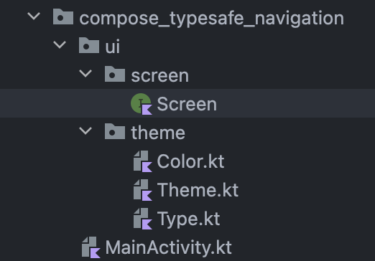
Setup Screen

Slide 42
Setup Screen
Sealed interface restricts the following classes:
package com.krillinator.compose_typesafe_navigation.ui.screen
import kotlinx.serialization.Serializable
sealed interface Screen {
@Serializable
data object Home: Screen
@Serializable
data object Login: Screen
@Serializable
data class User(val username: String, val password: String): Screen
}
Notera att när ‘screen’ kräver parametrar, så måste vi byta ut ‘object’ till ‘class’

Slide 43
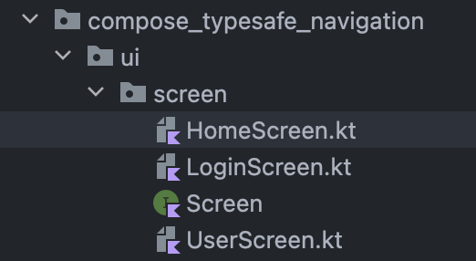
HomeScreen
@Composable
fun HomeScreen(navController: NavController, modifier: Modifier = Modifier) {
Column(
horizontalAlignment = Alignment.CenterHorizontally,
verticalArrangement = Arrangement.Center,
modifier = modifier
.fillMaxSize()
) {
Text(text = "Home")
Button(onClick = { navController.navigate(Screen.Login) }) {
Text(text = "NAVIGATE TO ${Screen.Login}")
}
}
}

Slide 44
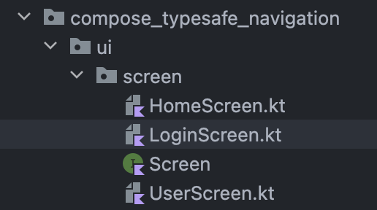
LoginScreen
See next page for bigger text
@Composable
fun LoginScreen(navController: NavController, modifier: Modifier = Modifier) {
var username by remember { mutableStateOf("") }
var password by remember { mutableStateOf("") }
Column(
horizontalAlignment = Alignment.CenterHorizontally,
verticalArrangement = Arrangement.Center,
modifier = modifier
.fillMaxSize()
) {
Text(text = "Login")
TextField(value = username, onValueChange = { username = it})
TextField(value = password, onValueChange = { password = it})
Button(onClick = { navController.navigate(Screen.User(
username, password
)) }) {
Text(text = "Login")
}
}
}

Slide 45
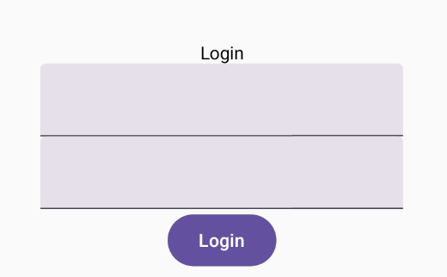
LoginScreen
@Composable
fun LoginScreen(navController: NavController, modifier: Modifier = Modifier) {
var username by remember { mutableStateOf("") }
var password by remember { mutableStateOf("") }
Column(
horizontalAlignment = Alignment.CenterHorizontally,
verticalArrangement = Arrangement.Center,
modifier = modifier
.fillMaxSize()
) {
Text(text = "Login")
TextField(value = username, onValueChange = { username = it})
TextField(value = password, onValueChange = { password = it})
Button(onClick = { navController.navigate(Screen.User(
username, password
)) }) {
Text(text = "Login")
}
}
}

Slide 46
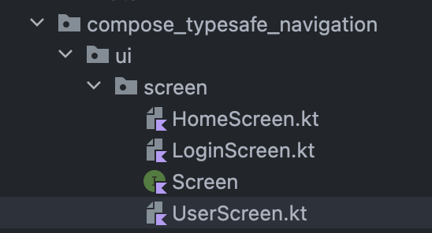
UserScreen
@Composable
fun UserScreen(username: String, password: String, navController: NavController, modifier: Modifier = Modifier) {
Column(
horizontalAlignment = Alignment.CenterHorizontally,
verticalArrangement = Arrangement.Center,
modifier = modifier
.fillMaxSize()
) {
Text(text = "User")
Text(text = "Welcome $username with password: $password")
}
}

Slide 47
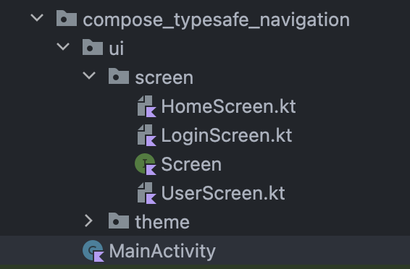
MainActivity

Slide 48
class MainActivity : ComponentActivity() {
override fun onCreate(savedInstanceState: Bundle?) {
super.onCreate(savedInstanceState)
enableEdgeToEdge()
setContent {
Compose_Typesafe_NavigationTheme {
Surface(
modifier = Modifier.fillMaxSize(),
color = MaterialTheme.colorScheme.background
) {
val navController = rememberNavController()
NavHost(
navController = navController,
startDestination = Screen.Home
) {
composable<Screen.Home> {
HomeScreen(navController)
}
composable<Screen.Login> {
LoginScreen(navController)
}
composable<Screen.User> {
val args = it.toRoute<Screen.User>()
UserScreen(args.username, args.password, navController)
}
}
}
}
}
}
}

Slide 49
val navController = rememberNavController()
NavHost(
navController = navController,
startDestination = Screen.Home
) {
composable<Screen.Home> {
HomeScreen(navController)
}
composable<Screen.Login> {
LoginScreen(navController)
}
composable<Screen.User> {
val args = it.toRoute<Screen.User>()
UserScreen(args.username, args.password, navController)
}
}
Notera att, it.toRoute<>()
Är så vi hämtar parametrar som data!

Slide 50
THANKS!
Do you have any questions?
kristoffer.johansson@sti.se
sti.learning.nu/
You can also contact me VIA Teams (quicker response) Du kan också kontakta mig VIA Teams (Snabbare svar)

